Slide 1
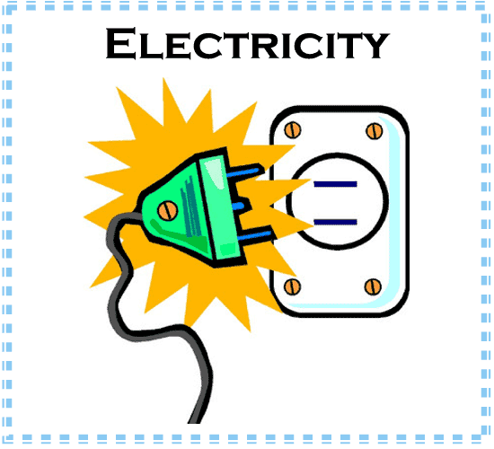
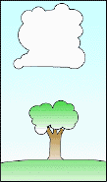
Chapters 20 and 21
Electricity and Magnetism
Notes:
*

Slide 2
Electrical Forces and Charges
Electrical Force: Force of attraction and repulsion that either pushes or pulls electrical charges.
Force of Attraction: Positive and negative charges coming together.
Force of Repulsion: Either positive and positive or negative and negative charges push away from each other.
Notes:
*

Slide 3
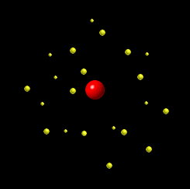
Ions
Charged particles.
How does a particle become charged?
  Rubbing separates charges on objects.
If an object gains electrons, the charge is negative.
If an object loses electrons, the charge is positive.
Notes:
*

Slide 4
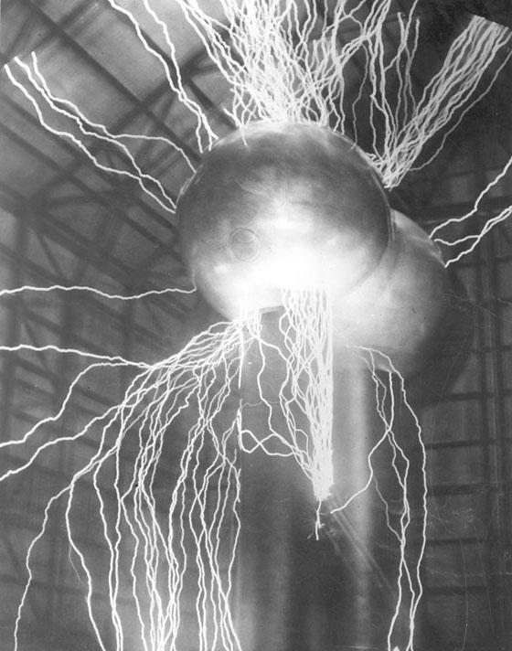
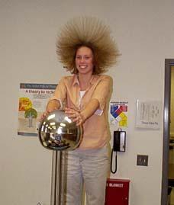

Static Electricity
Build up of charges on an object.
Discharge of electrons occur when a charged object “touches” another object. (clothes in dryer, rubbing feet over carpet and touching another object – feeling a shock)
Notes:
*

Slide 5
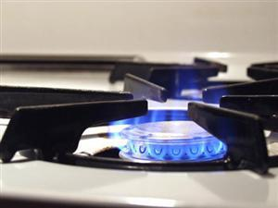
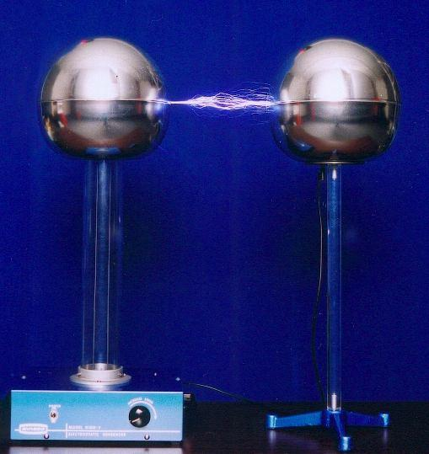
Two Methods to Charge Particles
Conduction
  Objects are charged by direct contact.
Induction
  Objects are
  charged by being near an object but NOT touching.
Notes:
*

Slide 6
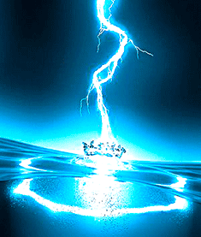
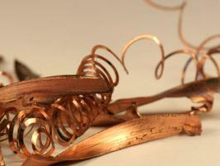
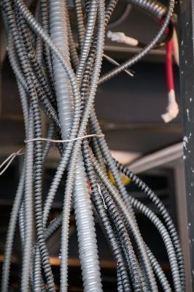
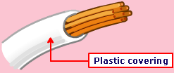
Insulators
Conductors
Insulators: Materials that DO NOT allow electrons to flow freely.
Examples: plastics, Styrofoam, rubber materials, wood, glass.
Conductors: Materials that allow electrons to flow freely through it.
  Example: Metals
Notes:
*

Slide 7
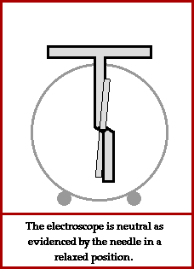
How do I show objects being charged?
Electroscope: Instrument that detects charges found on objects.
Leaves separate: negative charge
Leaves come together: positive charge
Notes:
*

Slide 8
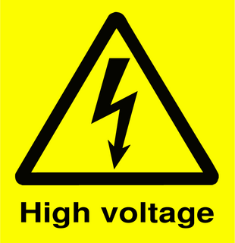
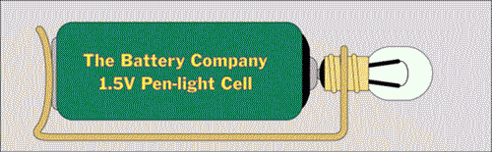
Flow of Electricity
Three Factors
Voltage: Potential Difference (volts - V)
Measure of energy available to move electrons.
  Push of electrons through a wire.
Notes:
*

Slide 9
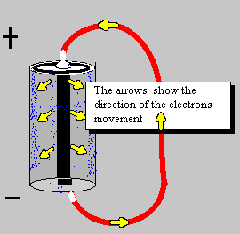
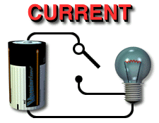
Flow of Electricity
Three Factors
Current: (ampere or amps - I)
Flow of electrons through a wire. Increase of current means and increase in the electrons flowing through a wire.

Slide 10
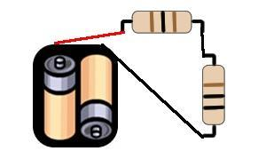
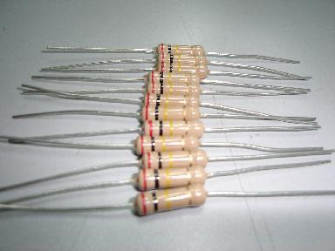
Flow of Electricity
Three Factors
Resistance: (ohms – R or Ω )
Stops or slows down the flow of electrons through a wire. Plastics have a high resistance and metals have a low resistance.

Slide 11
Factors that affect Resistance
Factors | High Resistance | Low Resistance
Length of wire | Long wires | Short wires
Thickness of wire | Narrow opening in wire | Wide opening in wire
Temperature | Hot temperatures | Cold temperatures
Notes:
*

Slide 12
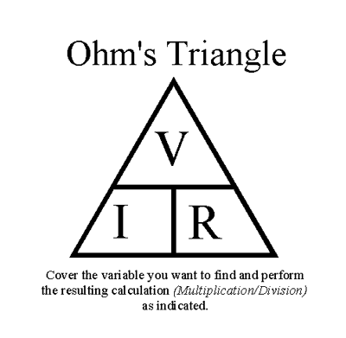
Ohm’s Law
The current in a wire is equal to the voltage divided by the resistance.
Formula V = IR
  I = amps (current)
  V = volts (voltage)
  R = ohms (resistance)
Notes:
*

Slide 13
Ohm’s Law Practice
V = IR
Volts | Current | Resistance
250 |  | 10
 | 50 | 5
300 | 100
 | 35 | 50
Notes:
*

Slide 14
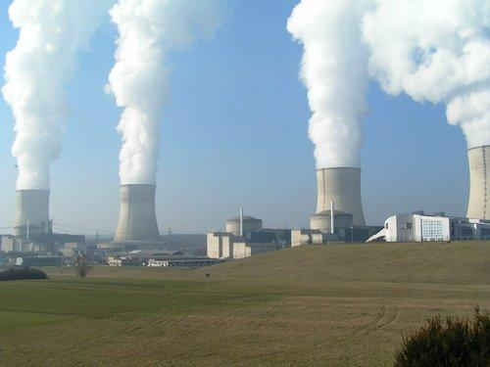
Electrical Power
Electrical Power: Measure of the rate at which electricity does work or provides energy.
Unit: watts
Formula: P = VI
Notes:
*

Slide 15
Electrical Power Practice
How much power is there when a 20-A current in a light bulb has a voltage of 10-V?
A 90-W light bulb has a current of 45-A. What is the voltage in the system?

Slide 16
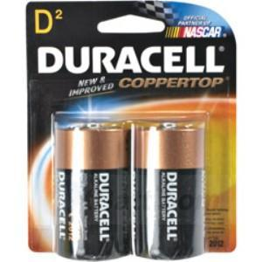
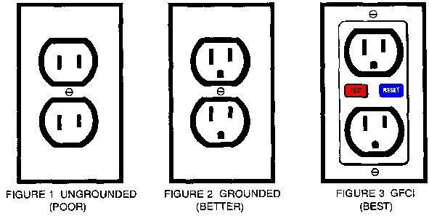
Electric Currents Can Either Be AC or DC.
DC or Direct Current: Electrons flow in the same direction.
Examples: dry cell batteries, car batteries.
AC or Alternating Current: Electrons have the ability to reverse their direction.
Outlets and wiring in a home or business.
Notes:
*

Slide 17
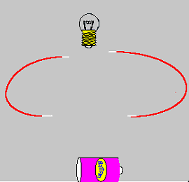
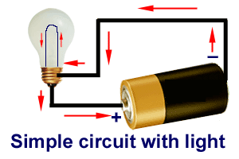
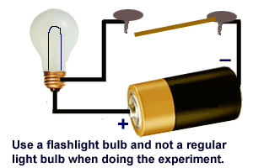
Circuits
A pathway in which the electrons flow.
Open Circuit: Switch is involved which can stop the flow of electrons.
Closed Circuit: No switch which means electrons flow automatically.
Notes:
*

Slide 18
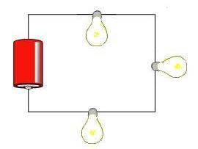
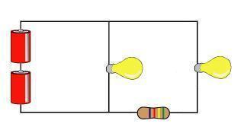
Types of Circuits
Series: One pathway
If a light bulb goes out, the flow of electrons stops.
Parallel: Multiple pathways that branch off the “series” circuit.
If a light bulb goes out in a branch, the other bulbs will still light.
Notes:
*

Slide 19
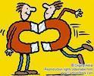
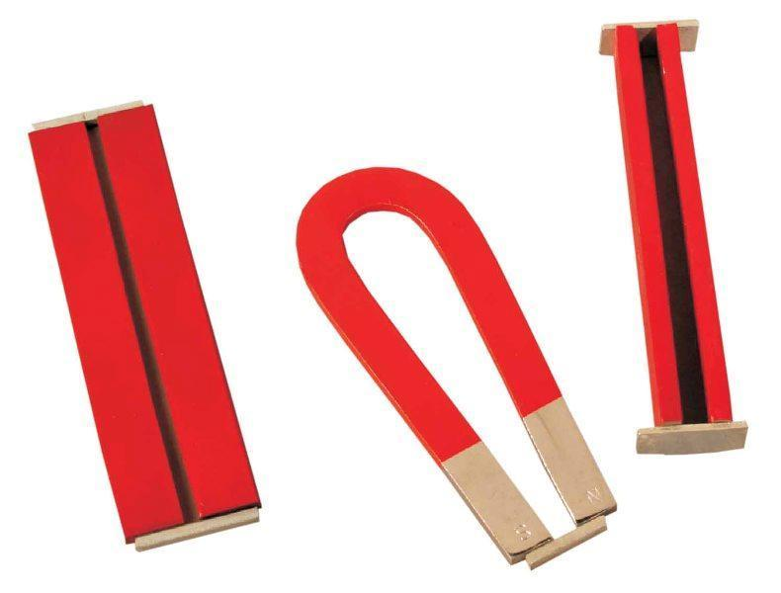
Magnetism
Force of attraction or repulsion between two objects.
Notes:
*

Slide 20
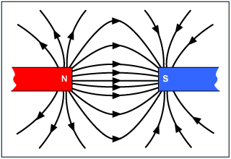
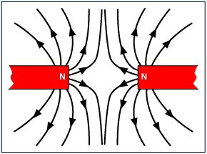
Magnetic Forces
Force of attraction: North and South Poles are attracted to one another.
  Opposites attract.
Force of repulsion: Same poles repel one another.
  N and N or S and S.
Strongest forces are found at the poles.
Notes:
*

Slide 21
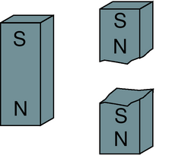
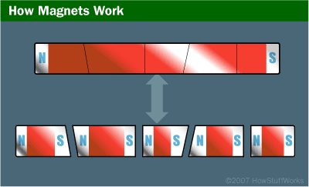
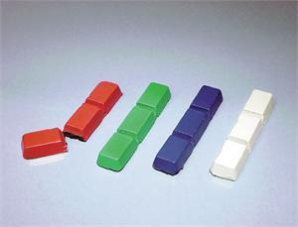
Breaking Magnets
If I split a magnet in two equal part, what would I get?
  Two smaller and equal magnets.
Notes:
*

Slide 22
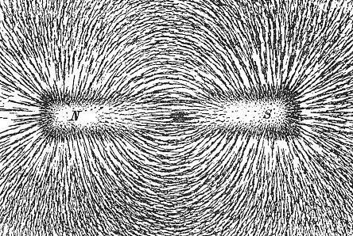
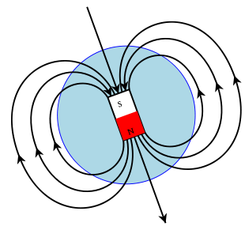
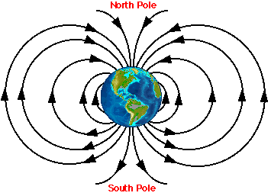
Magnetic Field
The closer you are to the poles, the stronger the magnetic attraction or repulsion.
Notes:
*

Slide 23
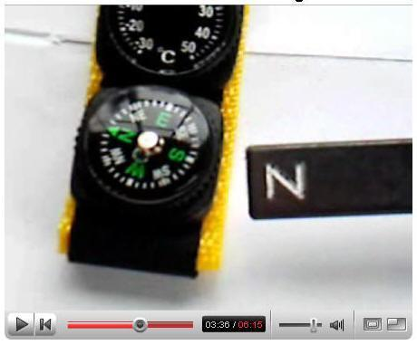
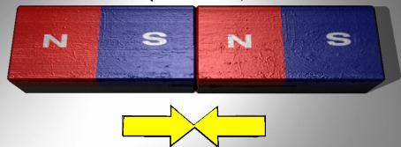
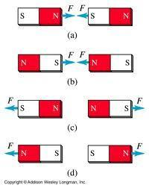
Parts of a Magnet
N on a magnet points to Magnetic North
S on a magnet points to Magnetic South
Notes:
*

Slide 24
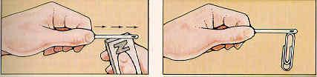
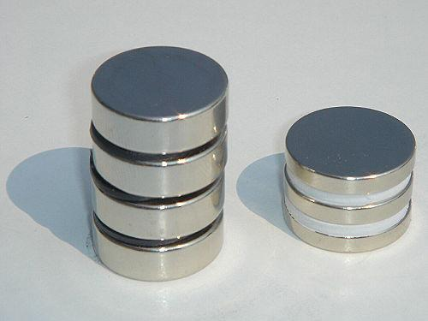

Temporary vs. Permanent Magnets
Temporary: easily magnetized but loses strength quickly.
Permanent: hard to magnetize but keeps its strength a long time.
Magnetic elements: cobalt, nickel, iron, aluminum
Notes:
*

Slide 25
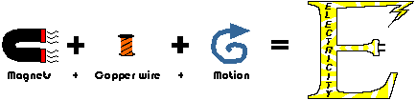
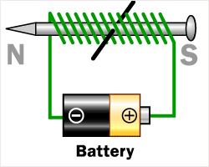
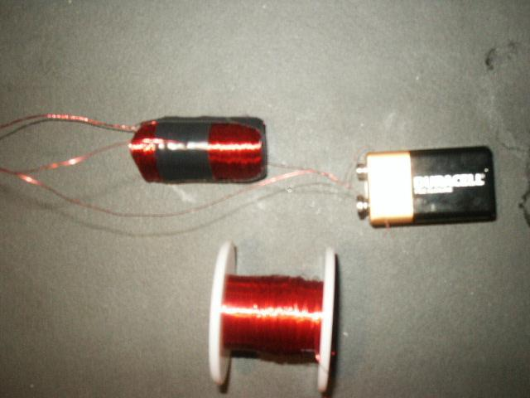
Solenoid and Electromagnets
Electricity is used to make magnetic materials.
Parts of an electromagnet:
wire, battery, nail
Examples: motors, door bells, washing machines, telephones, telegraphs.
Notes:
*

Slide 26
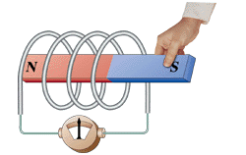
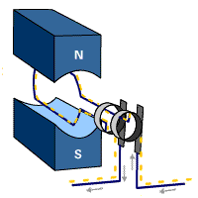
Galvanometer and Electromagnetic Induction
An instrument used to detect small currents by using electromagnetic induction.
Electromagnetic Induction: Using mechanical energy to produce electrical energy.
Example: generators
Notes:
*

Slide 27
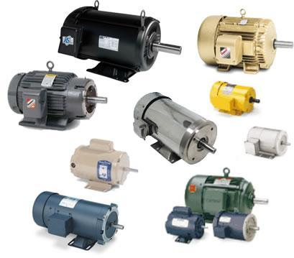
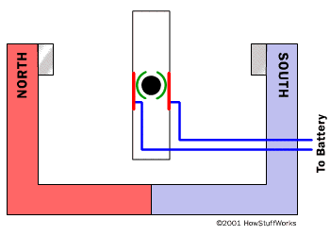

Motor vs. Generators
Oerstead
Motors: converts electrical energy to mechanical energy.
Uses electromagnets
Faraday
Generator: converts mechanical energy to electrical energy.
Uses electromagnetic induction.
Notes:
*

Slide 28
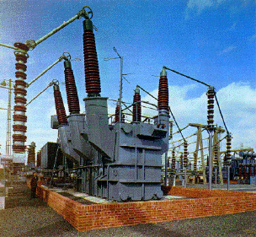

Transformers
Increases or decreases voltage in AC. Has primary and secondary coils in the “boxes”.
Types:
  Step Up: INCREASES
  Step Down: DECREASES
Notes:
*

